Slide 1


March 2015 GP Survey: Are you getting paid fairly?

Slide 2
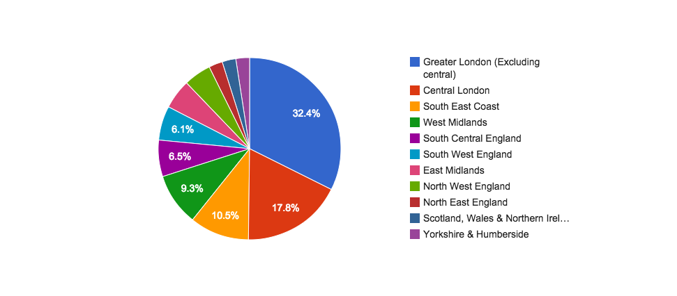
Where do you work?
Are you being paid fairly?

Slide 3
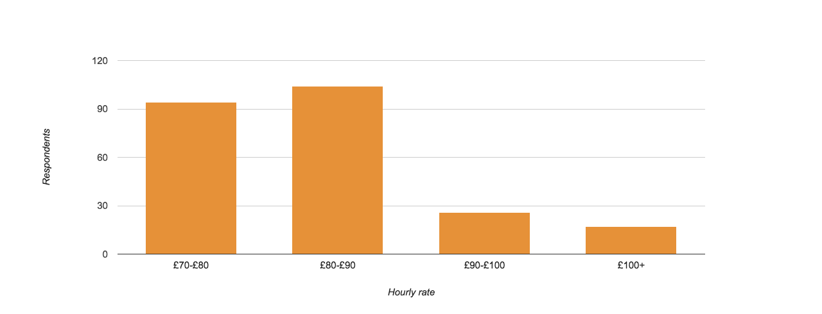
How much on average do you get paid for regular work?
* not emergency, where you are given more than 48 hours notice
Are you being paid fairly?

Slide 4
Average monthly wage for locum work
Network Locum
GPs
Non NL GPs
£4600
£4113
Are you being paid fairly?

Slide 5
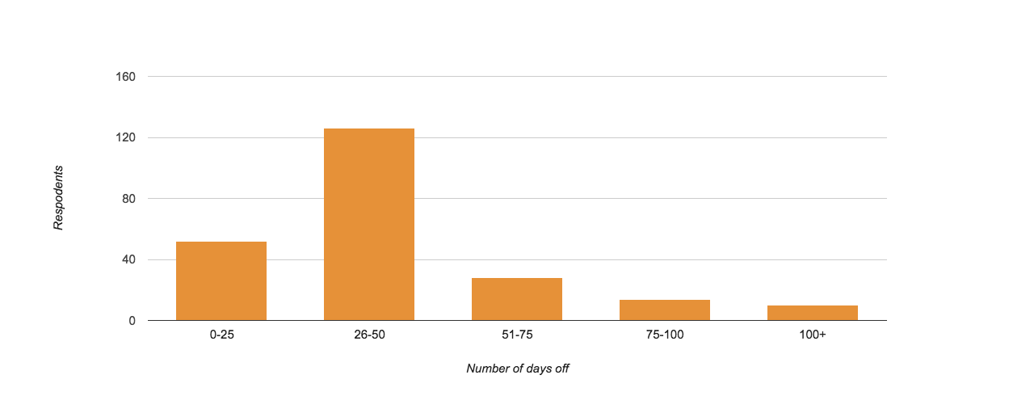
Days off
Are you being paid fairly?

Slide 6
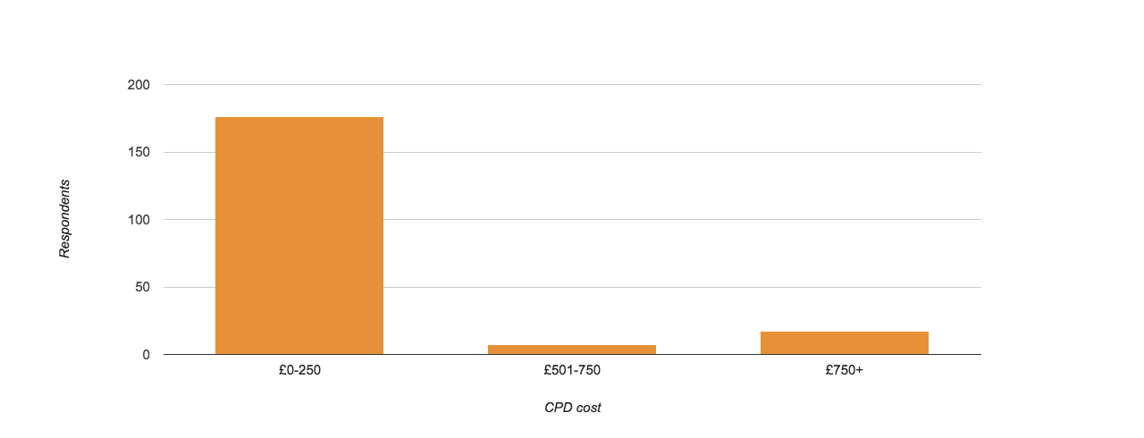
How much do you spend on CPD per month?
Are you being paid fairly?

Slide 7
How much on average do you charge for home visits?
£22
Are you being paid fairly?

Slide 8
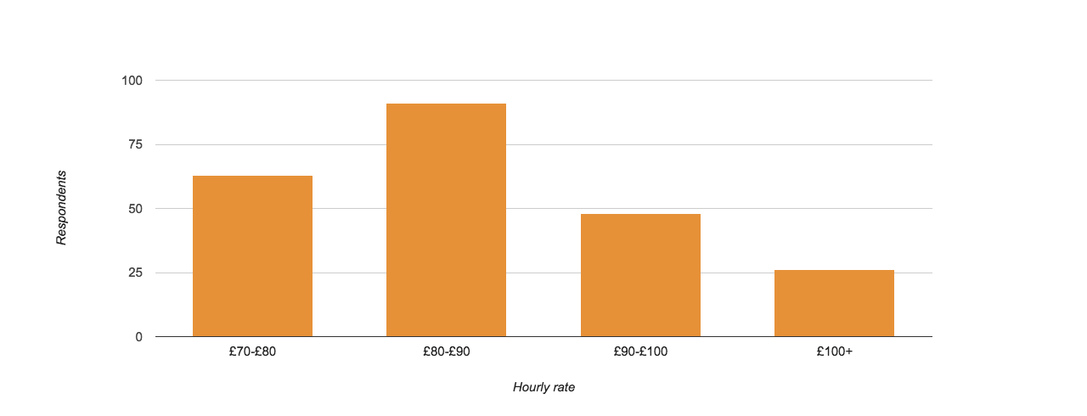
How much on average do you get paid for emergency work?
* emergency being less than 48 hours notice
Are you being paid fairly?

Slide 9
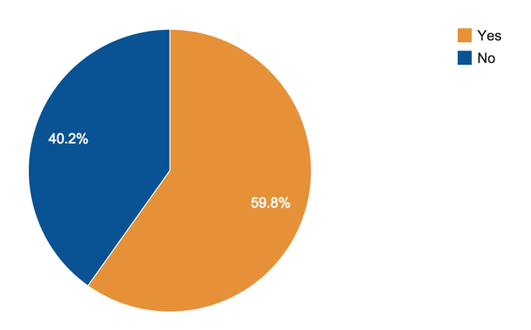
Do you claim NHS pension?
Are you being paid fairly?

Slide 10
Thanks for viewing our survey results!
We are always looking for more GPs to get involved in Network Locum, email jess@networklocum.com for more details

